Slide 1

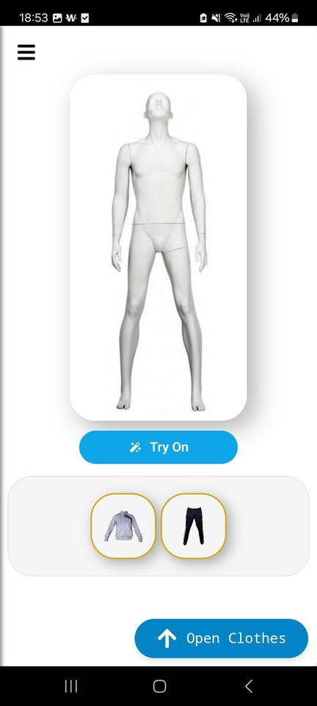
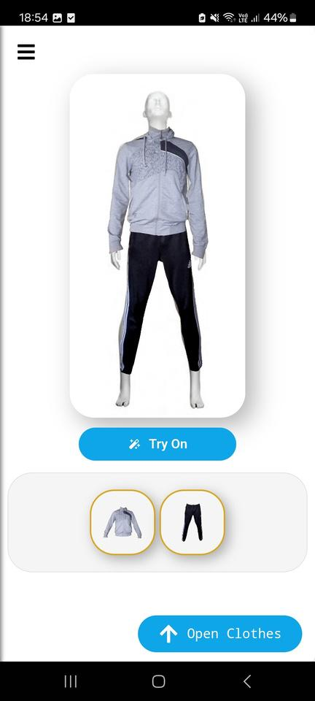
Virtual Fitting - Real Confidence
Your Virtual Fitting Room

Slide 2




Our team
Ignacy Byshniou
Senior Engineer 1
Tim Barvenov
Senior Engineer 2

Slide 3

Virtual fit platform
Project goal
Our goal is to build a platform where anyone can virtually try on clothes and easily find items that fit both their style and body.
Future of fashion commerce
Trying something new shouldn't be a problem. Check out Weavella!
We believe that within a few years, virtual fitting rooms will become the primary way people select and purchase apparel.
AI styling assistant
Our vision is to create a simple, AI-powered app that uses a single prompt to suggest multiple outfit options tailored to the user’s preferences and measurements.

Slide 4




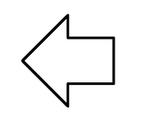
Problem
Current online clothing and footwear stores offer a huge number of products. However
Visualization Challenge
Size and Fit Confusion
Overwhelming Choices
Confusing Comparisons
Customers can’t visualize how items will really look on them.
Customers don’t know which products fit their body shape and size.
The abundance of products can make choice overwhelming —sometimes a stylist is needed to narrow down and advise on the options.
Products are presented in a non-uniform way, making it difficult to compare and select one.
Customers can’t visualize how items will really look on them.
A longer purchase process
(more abandoned carts)
Higher rates of returns
Some customers switching back from online to brick-and-mortar stores

Slide 5

Unified 3D clothing view
Values we want to offer
Clothing visualization in an attractive, unified 3D/360 format
Realistic avatar visualization
The ability to see their own avatar in selected clothes in a way that is as close to reality as possible
Intelligent size recommendations
Intelligent sizing suggestions and fit assessments
AI outfit stylist
An AI stylist that suggests outfits according to user preferences
In-app store integration
An integrated store with convenient purchase options

Slide 6


BUSINESS ROADMAP
1
2
3
4
5
Real-time body position detection (arms, legs, head, etc.)
Favorites (wishlists) and user account features (registration/login)
Categorizing clothes and enabling search among them
Adding new clothes using AI image segmentation
Virtual try-on
10
9
8
7
6
Enabling in-app clothing purchases (store integration)
Recommendation system and AI fashion consultant
Refine the try-on algorithm for greater realism
Adapting algorithms for 3D representation of clothes and models
Analyzing user measurements: body scanning and size recommendations
11
Direct purchases from the app

Slide 7

Competition
Clothing Try On
Makeup and Glasses
There are many solutions worldwide attempting to tackle the virtual fitting room problem. However, these solutions are generally still immature and function more like novelties rather than real products solving genuine customer needs.
When it comes to eyewear and makeup, there are several solutions that are already quite advanced (e.g., L’Oréal, PerfectCorp).
Our opportunity
Therefore, we see a chance of becoming the first practically used solution in the realm of virtual fitting rooms.
Comprehensive description of the best solutions:
https://docs.google.com/document/d/1PdeUl9FoaH_0mfJpdBnX8_qBXh3yjdMn/edit?usp=sharing&ouid=118266537685445163856&rtpof=true&sd=true

Slide 8
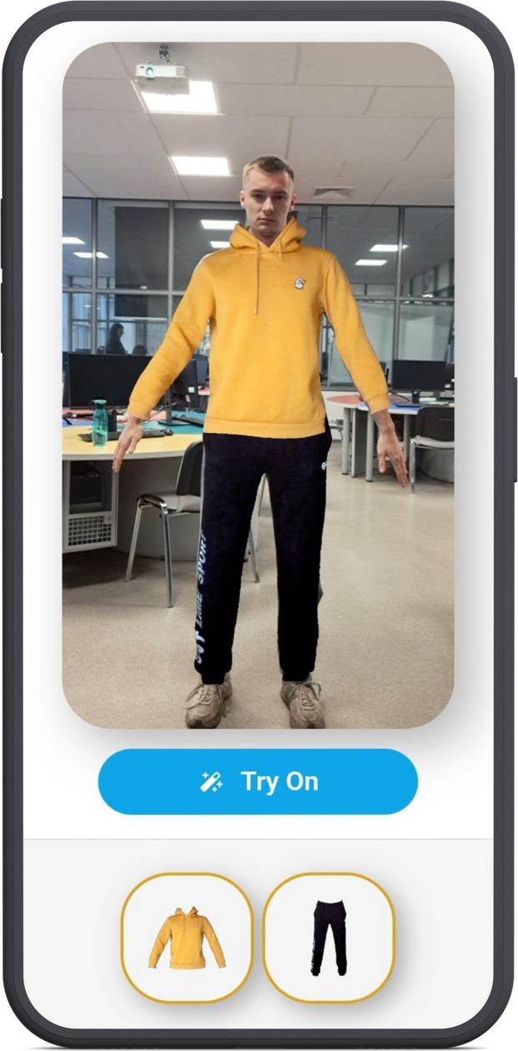
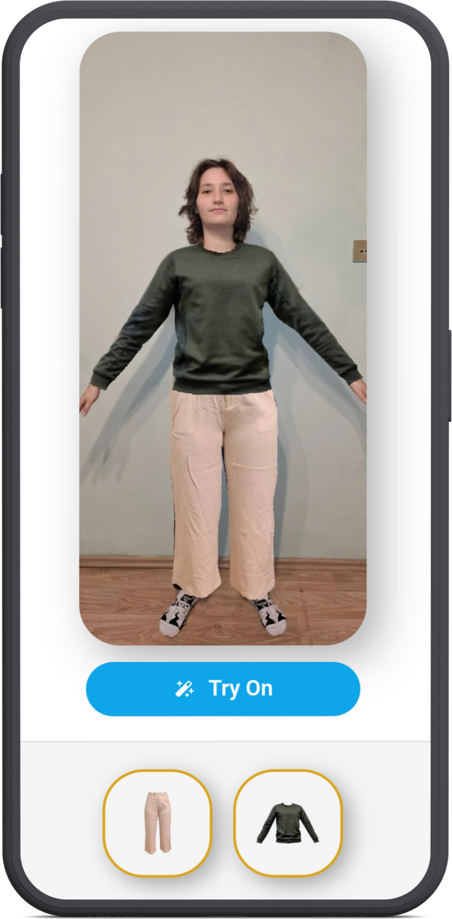
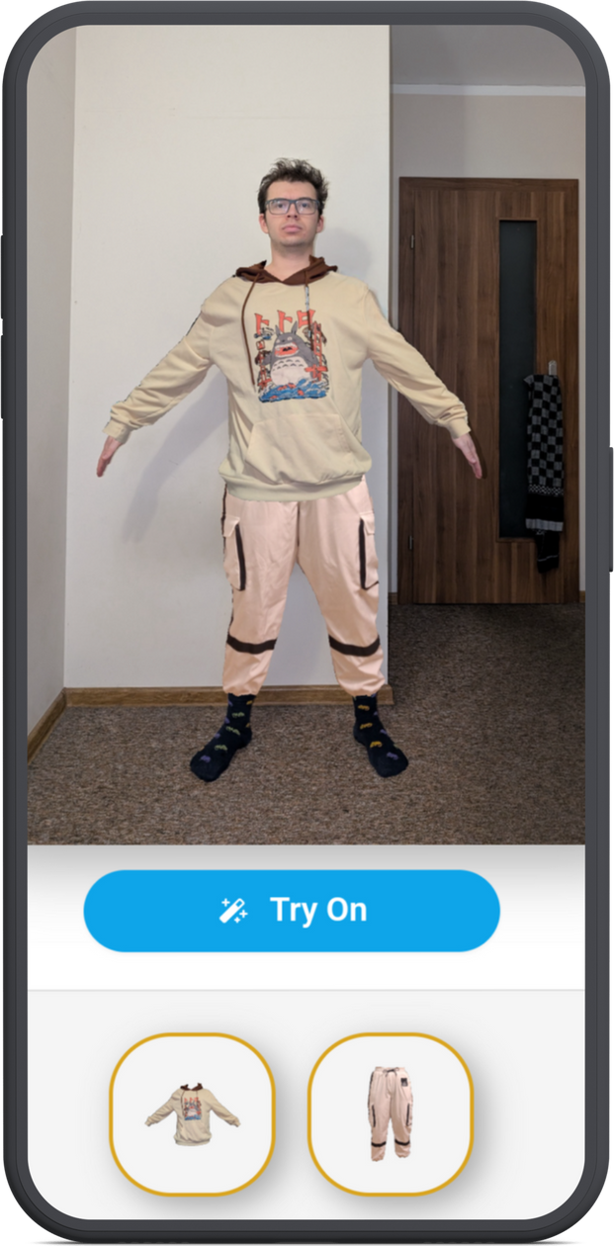
Virtual fitting on your own photo

Slide 9
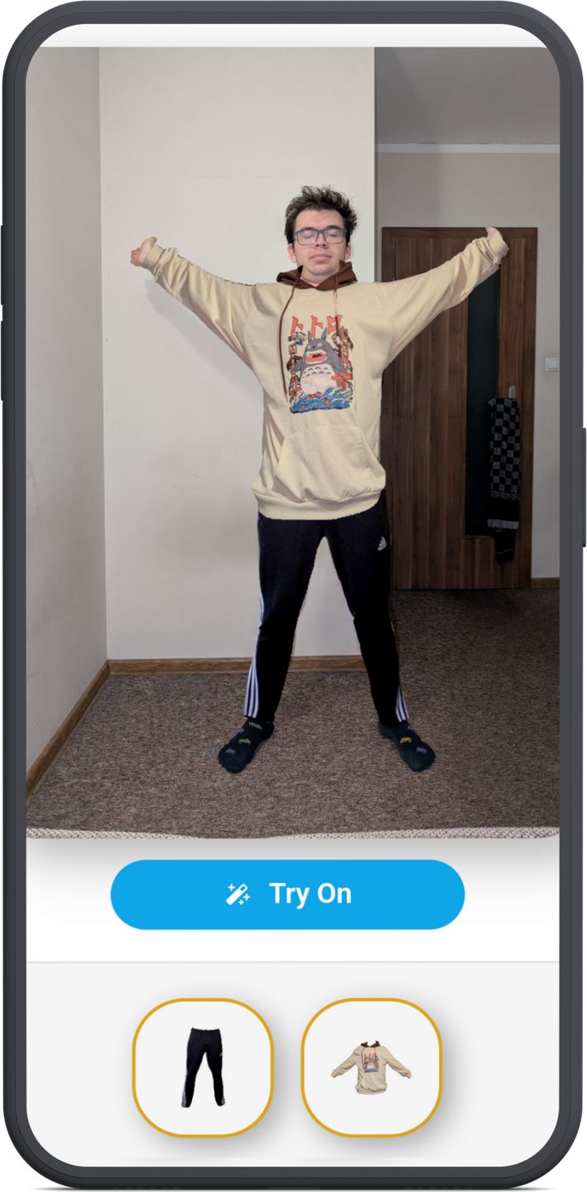
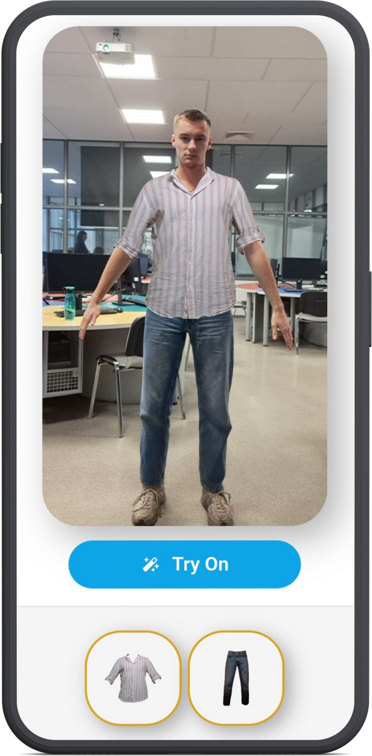
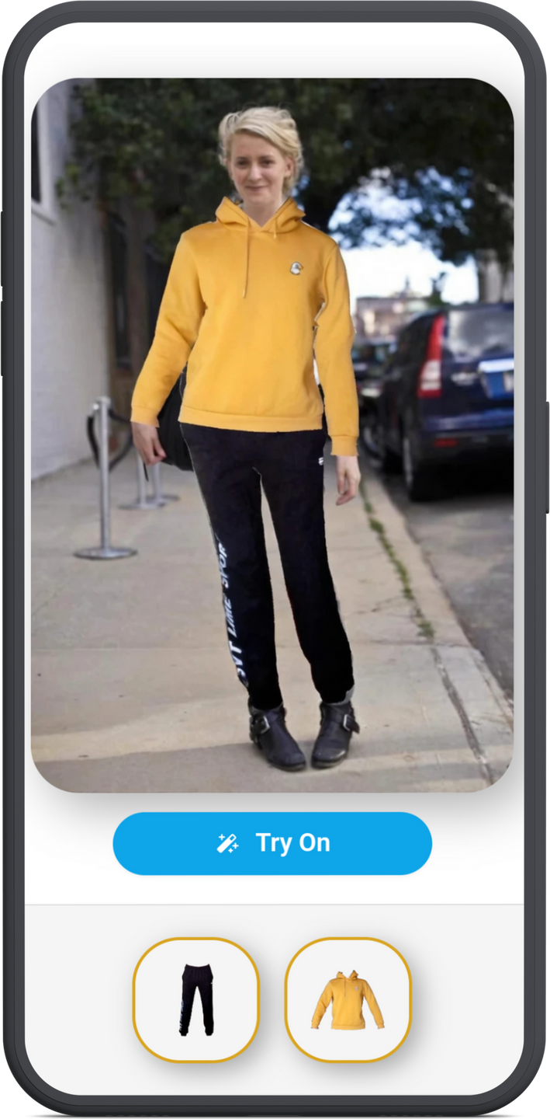

Slide 10
Value proposition for Partners
A unique market differentiator: riding the AI buzz
Transition offline customers to online platforms
01
05
Increased customer interest (gaining early adopters)
Collecting customer contacts (email, phone, marketing consents) from offline customers
02
06
Better purchase decisions ➝ Fewer returns
03
Increased user retention through periodic mailing and in-app pop-ups with new personalized styling suggestions
07
Faster purchase decisions ➝ More / Increased sales
04

Slide 11
Monetization
Commission on sales
Weavella will earn a 20% commission on each sale made through the app, partnering with fashion brands and retailers to facilitate seamless in-app purchases
Clothes promotions in the app
Brands can promote their clothing items within the app, ensuring higher visibility to users actively looking for outfit inspiration and virtual try-ons
Fees for marketing
Businesses can run targeted marketing campaigns within Weavella, leveraging user data and preferences to reach potential buyers effectively.
Implementation and maintenance fees
Retailers and brands integrating their collections into Weavella will pay fees for onboarding, technical implementation, and ongoing maintenance of their digital storefronts, if the technology is implemented for a specific store (both in shopping center and online models)

Slide 12
eavella
Thank you

