Slide 1
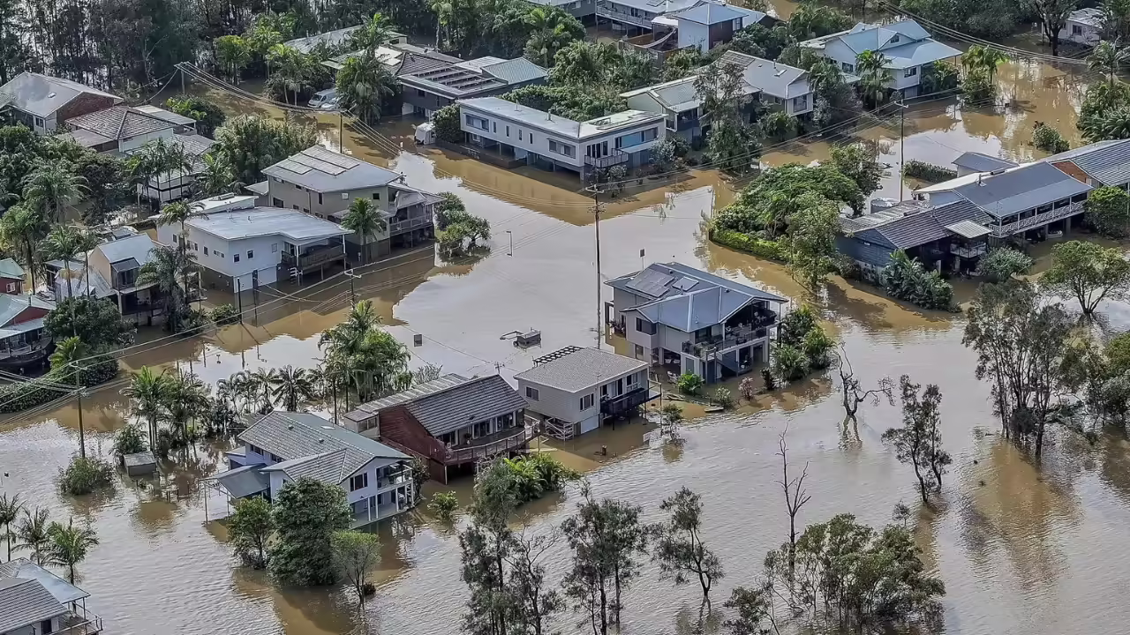
CityRoot
Real-time flood simulation in urban environment

Slide 2

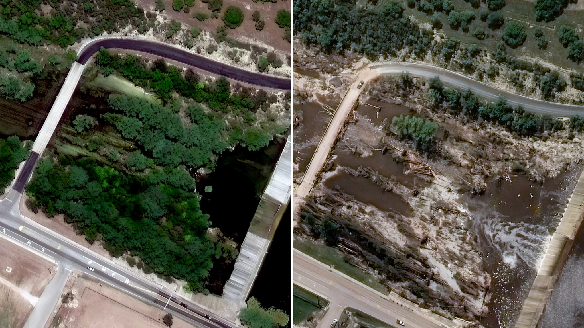
Problem
Floods are devastating events influenced by many factors
Consequences of floods could be mitigated with proper planning if we were able to predict them
Texas, July 2025

Slide 3

Solution - computer simulation
The goal is to develop a software that:
reconstructs an urban scene from real data with special focus on vegetation
interactively simulates a flood using an advanced model of the physics of fluids, soil, and vegetation with 3D visualization
allows altering the reconstructed scene to predict the effects of these changes and find optimal arrangements of urban landscape

Slide 4
Our contributions
Scene reconstruction with AI agent => higher accuracy and flexibility than existing procedural models
Modeling the influence of soil and root system on plant behaviour under flood conditions => advantage over existing plant physics models

Slide 5


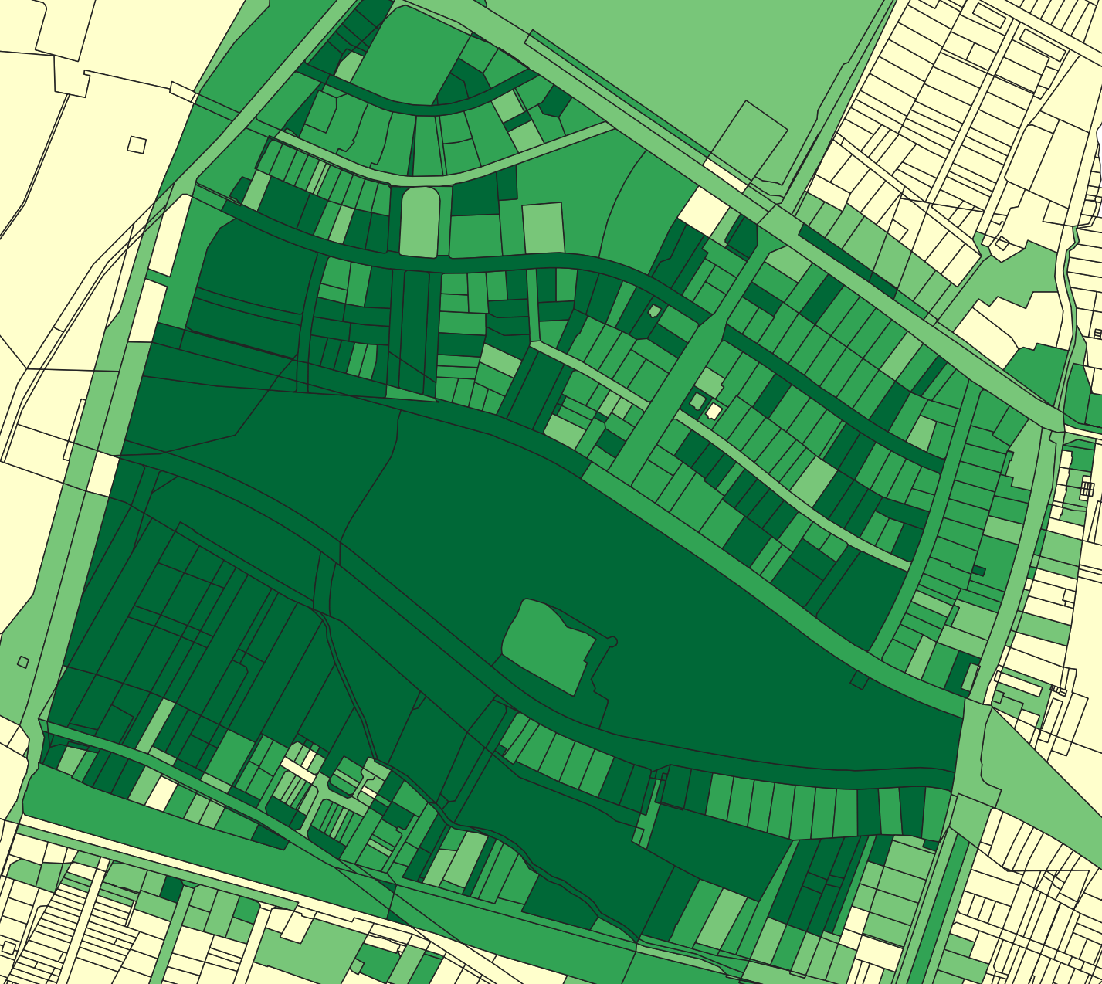
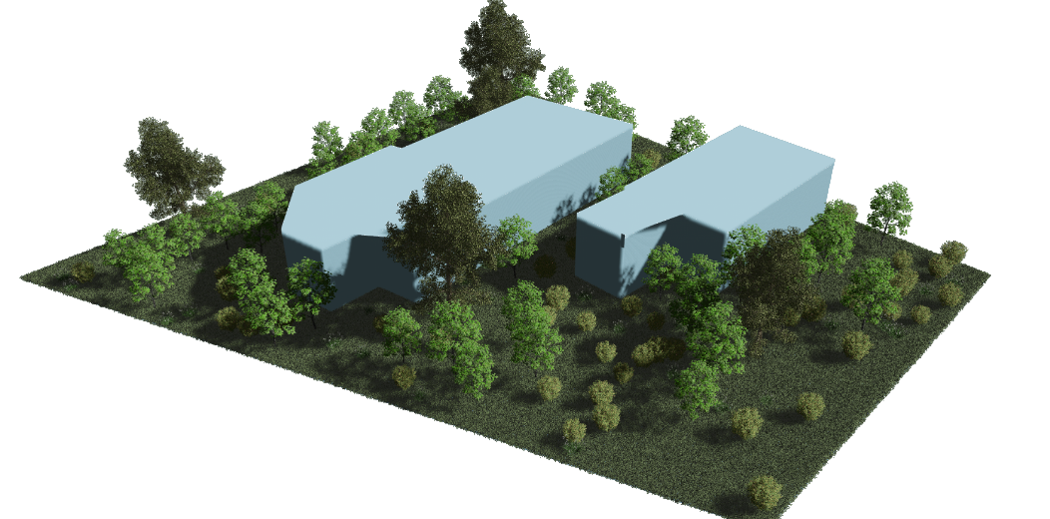
Reconstruction
We use real geographical data from city database using a measure of health and density of vegetation to reconstruct a parcel with buildings and plants

Slide 6
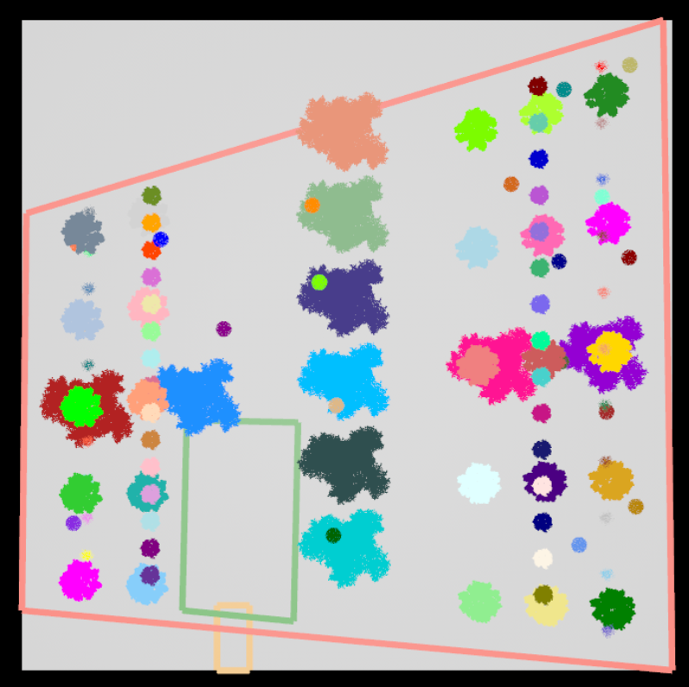
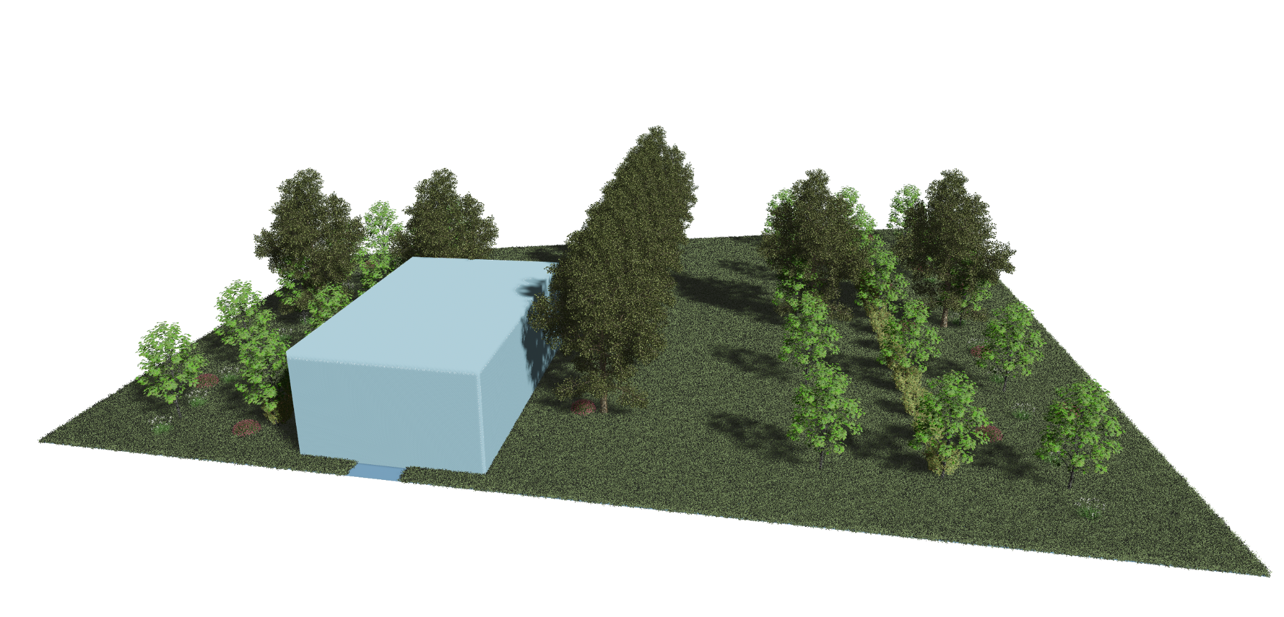
AI agent placement
Using parcel and building data we utilize an AI agent to rearrange vegetation according to a specific style (in this case a French garden)

Slide 7
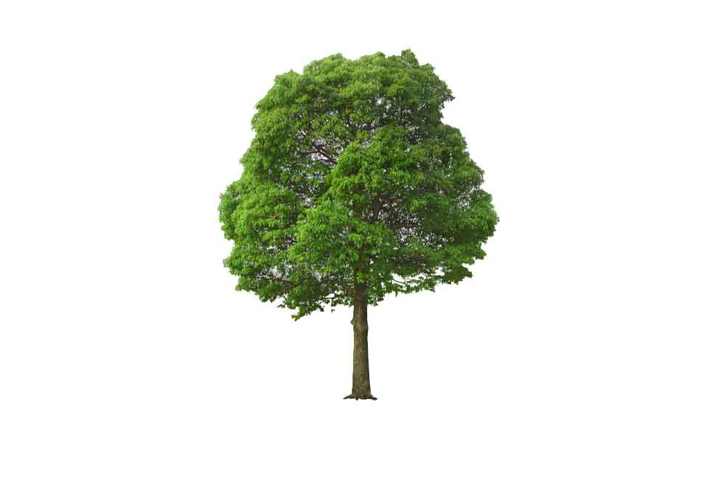

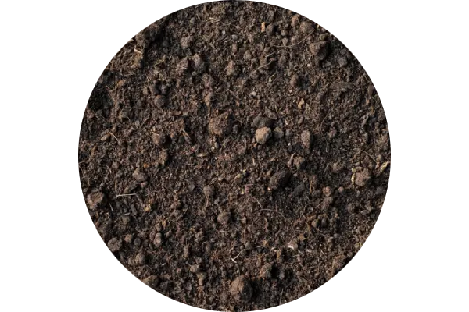
The physics model
Atmosphere
(wind and water)
Vegetation
Soil

Slide 8
Atmosphere exerts force on the plants
Plants influence wind and water movement
Atmosphere causes erosion
Soil keeps the plant in place
Soil absorbs water
Roots influence soil structure

Slide 9
Team members
Marcin Marlewski:
data acquisition
scene reconstruction
vegetation assets preparation
Mateusz Szlachetka:
computer graphics algorithms
physics modeling
engine programming

Slide 10
Timeline
Done:
reconstruction of urban landscape on parcel level
implementation of plant physics using rod model
Q4 2025
reconstruction of a significant part of the city
formulation and implementation of soil model
Q1 2026
implementation of fluid physics model
full physics framework integration
Q2 2026
rendering engine for visualization
scene editing tool

Slide 11
Summary
FOR people working in ecology, urban planning, or 3D animations
WHO need realistic simulations of natural phenomena
CityRoot is a framework for simulating floods in urban environment
THAT achieves higher fidelity than existing reconstruction and physics models

